Slide 1

Disk & File System Management
CSC 235 Introduction to Linux, Linux Admin & Mgmt
Instructor, Joel C. Nonnweiler
Email: jnonnweiler@stmartin.edu

Slide 2
Agenda
Storage Concepts [8.1]
MBR Disk Partitions [8.2]
GUID Partitions [8.3]
Logical Volume Manager (LVM) [8.4]
File Systems [8.5]
Mounting File Systems [8.6]

Slide 3
Storage Concepts
Storage types (internal storage, RAID, external storage, and iSCSI)
FUSE (requirements & purpose)
RAID on Linux (mdadm, Boot disk, and RAID types)

Slide 4
Key Terms/Definitions
Block storage
Master Boot Record (MBR)
Globally Unique Identifier (GUID) Partition Table (GPT)
Storage used by Linux to store traditional data in blocks or chunks of space (also called a block device).
The traditional partition type used for storage devices.
The successor to MBR partition tables. It provides much more storage capability and partition flexibility.

Slide 5
Storage Types
Internal storage
Magnetic Optical Solid state
External storage
Higher capacity SAN NAS

Slide 6
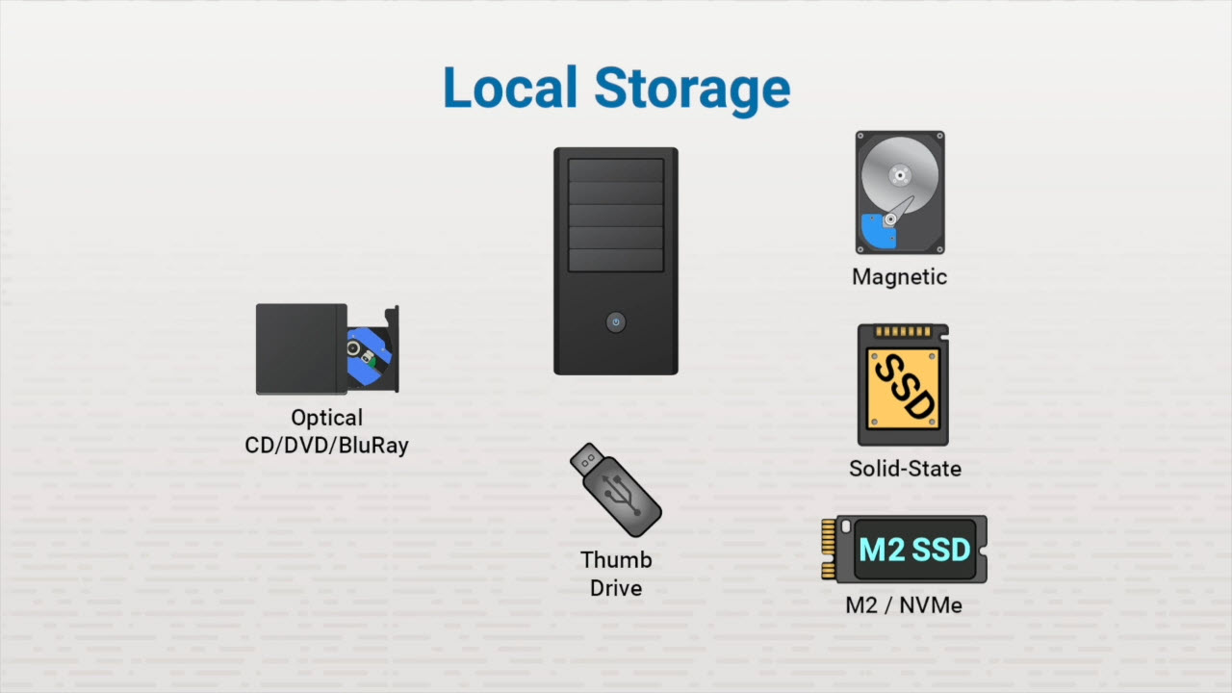
Storage Types

Slide 7
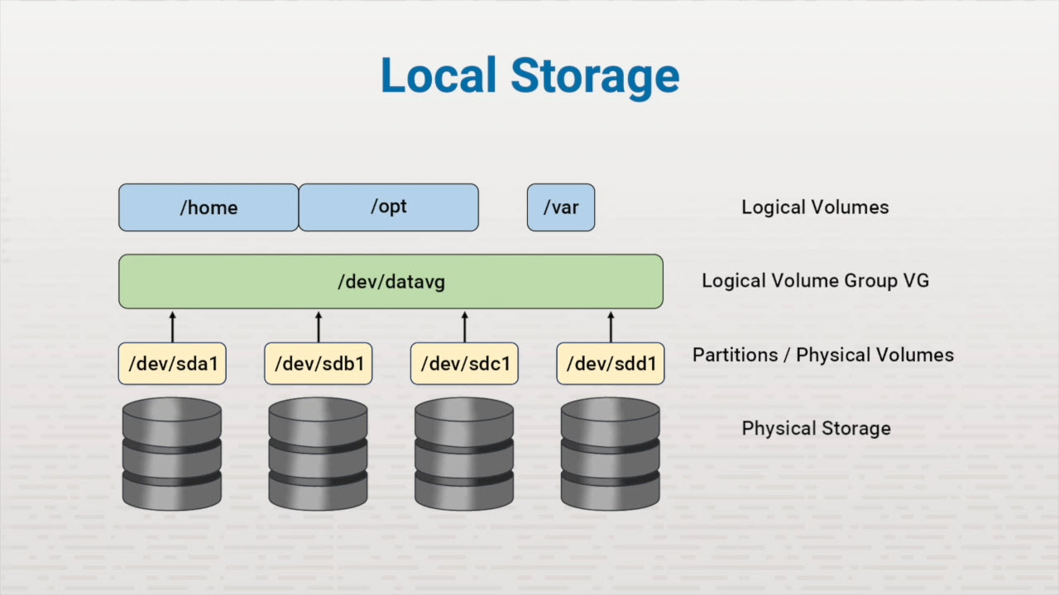
Storage Types

Slide 8
RAID
Redundant Array of Independent Disks Capacity or redundancy RAID Levels:
RAID 0 - Striping RAID 1 - Mirroring

Slide 9
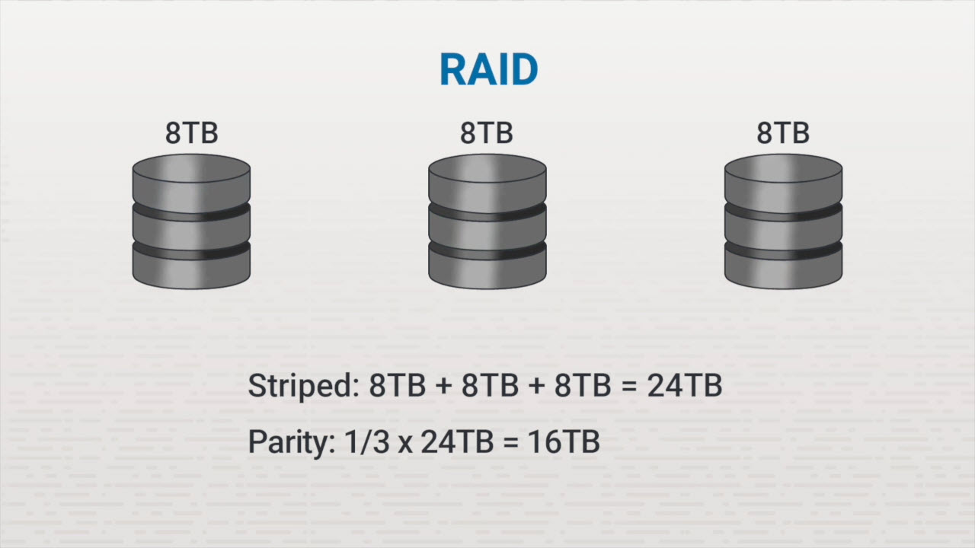
Storage Types

Slide 10
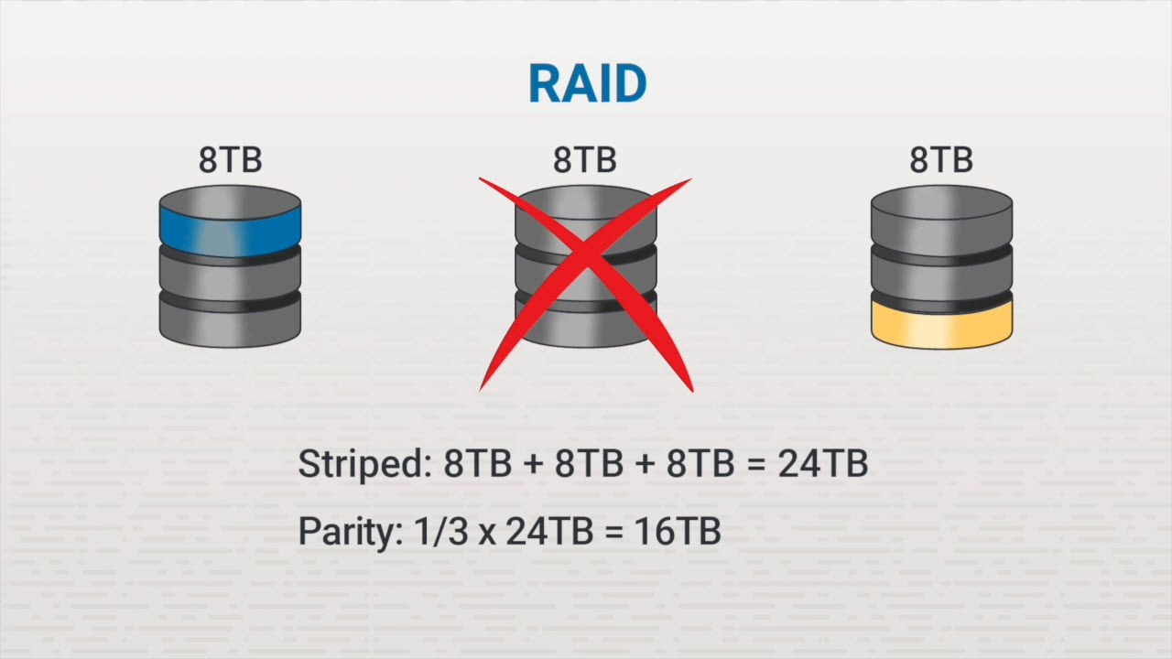
Storage Types

Slide 11
RAID
RAID 6
Striping Double parity
RAID 1+0 or 0+1
Mirror of stripes Stripe of mirrors

Slide 12
External Storage
Network Attached Storage
Connected to network Shares to users
Storage Area Network
Hardware and software Services to diskless Direct to servers
iSCSI - SAN over Ethernet Initiator - clients Target - storage device Separate network (10 Gbps)

Slide 13
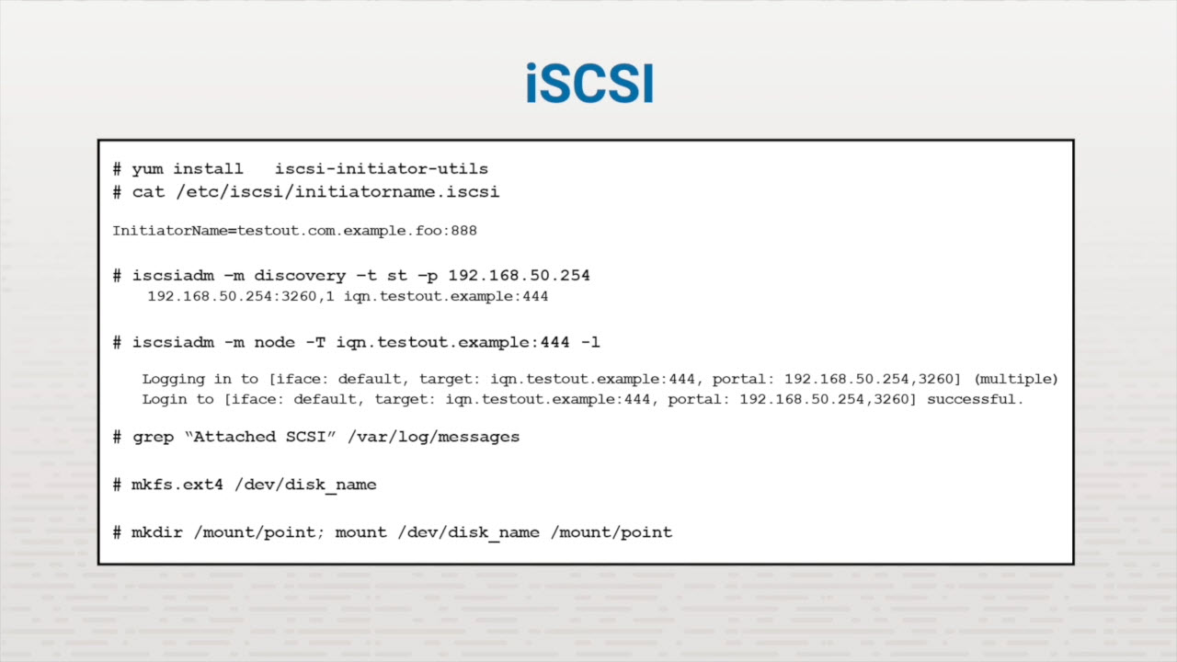
Storage Types

Slide 14
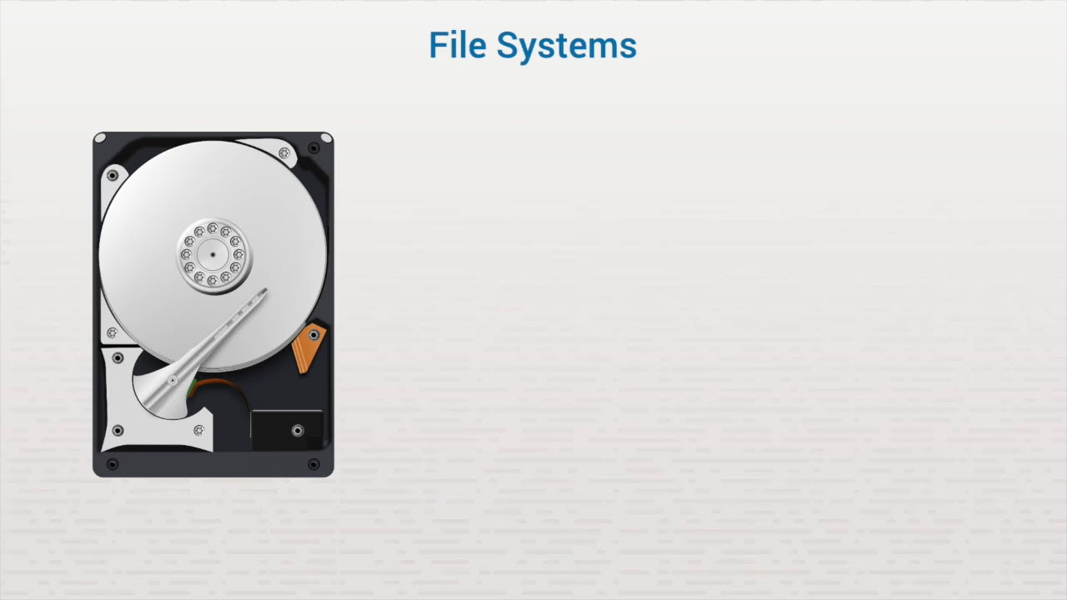
FUSE

Slide 15
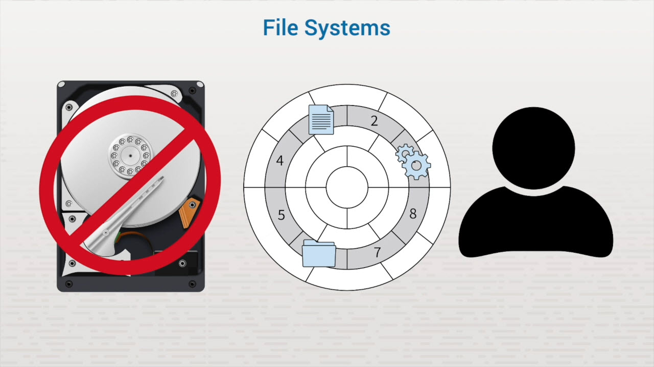
FUSE

Slide 16
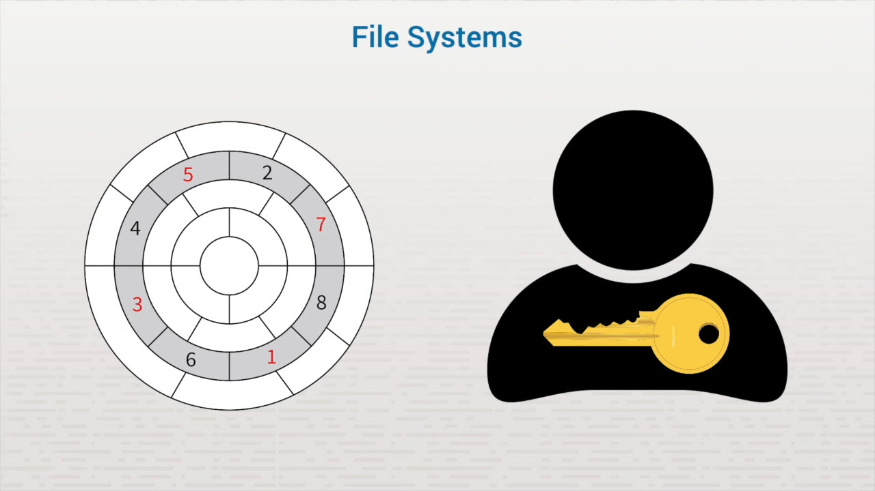
FUSE

Slide 17
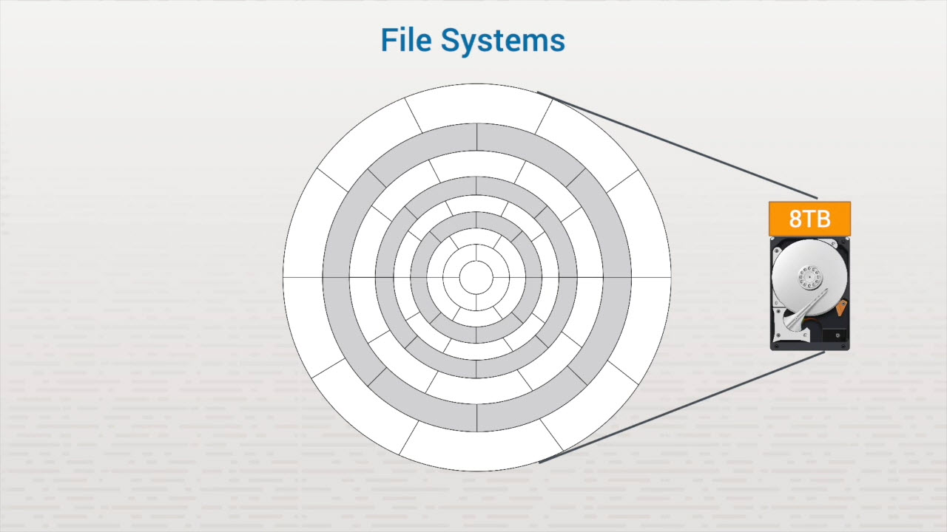
FUSE

Slide 18
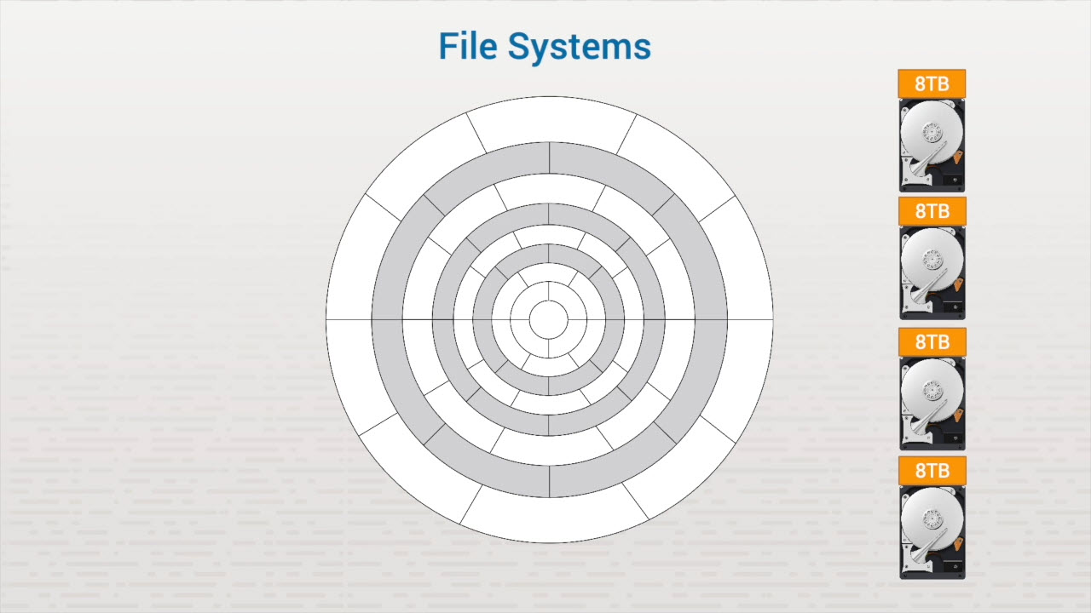
FUSE

Slide 19
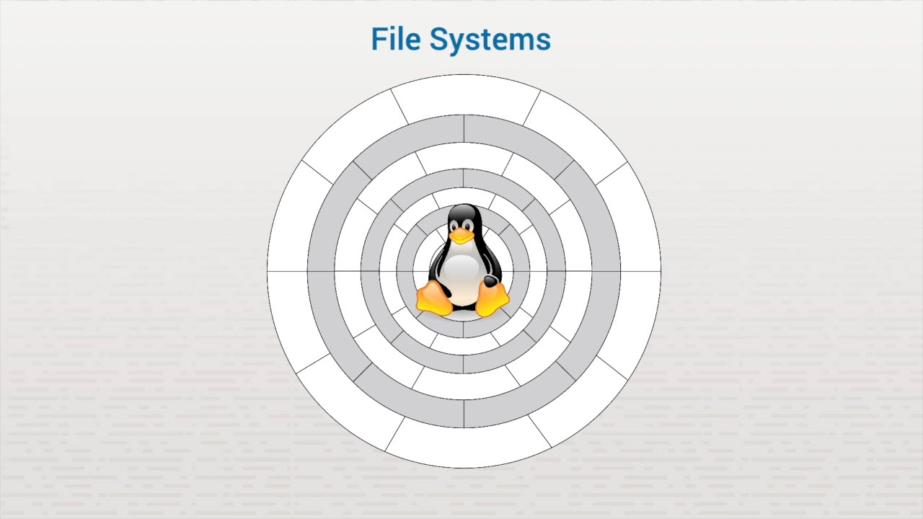
FUSE

Slide 20
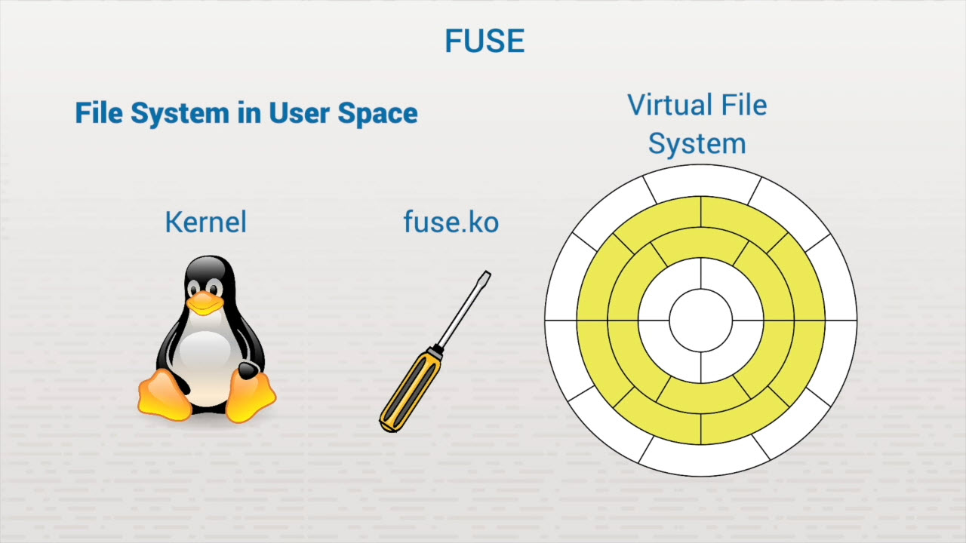
FUSE

Slide 21
FUSE Requirements
A kernel module (fuse.ko) User space library (libfuse) Mount utility (fusermount)

Slide 22
Purpose of FUSE
Control over file operations Portable file systems Stable environment

Slide 23
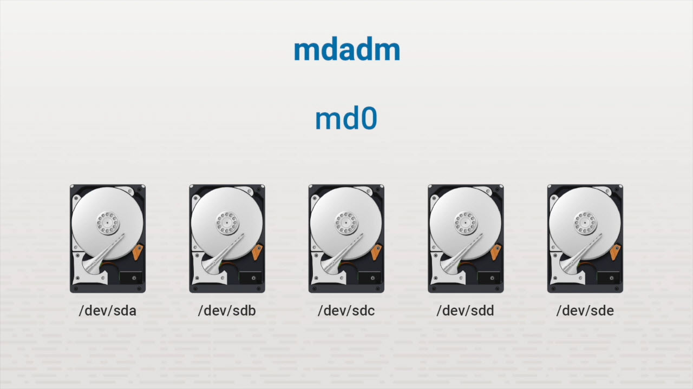
RAID on Linux

Slide 24
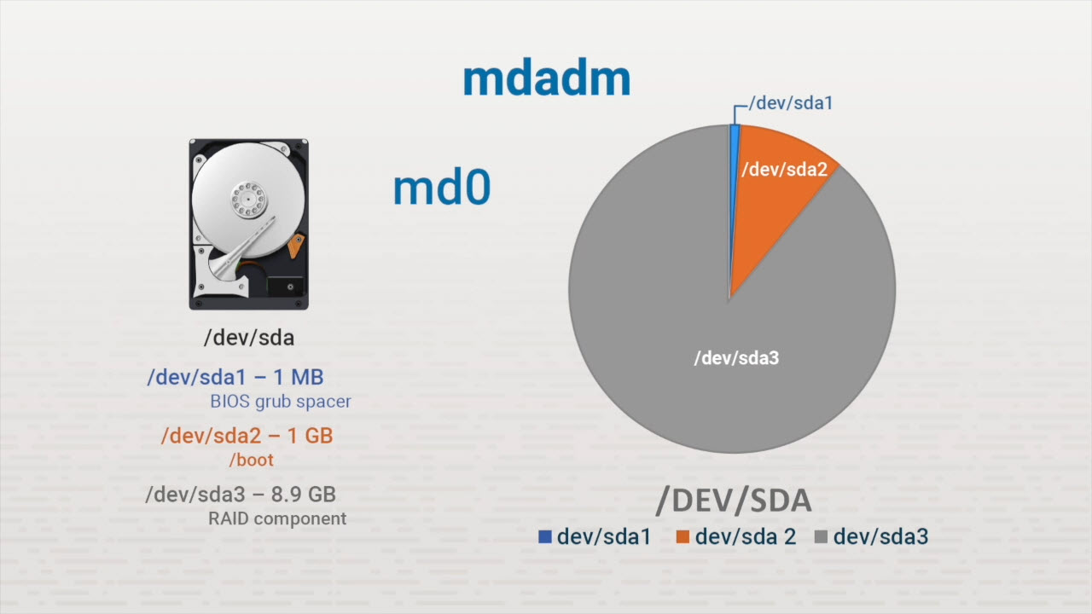
RAID on Linux

Slide 25
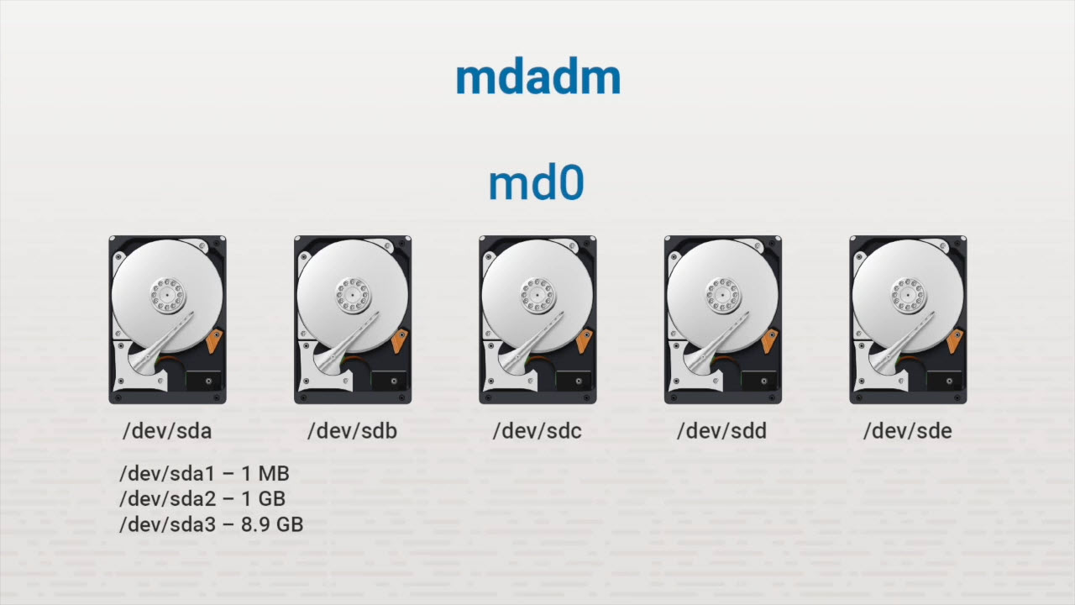
RAID on Linux

Slide 26
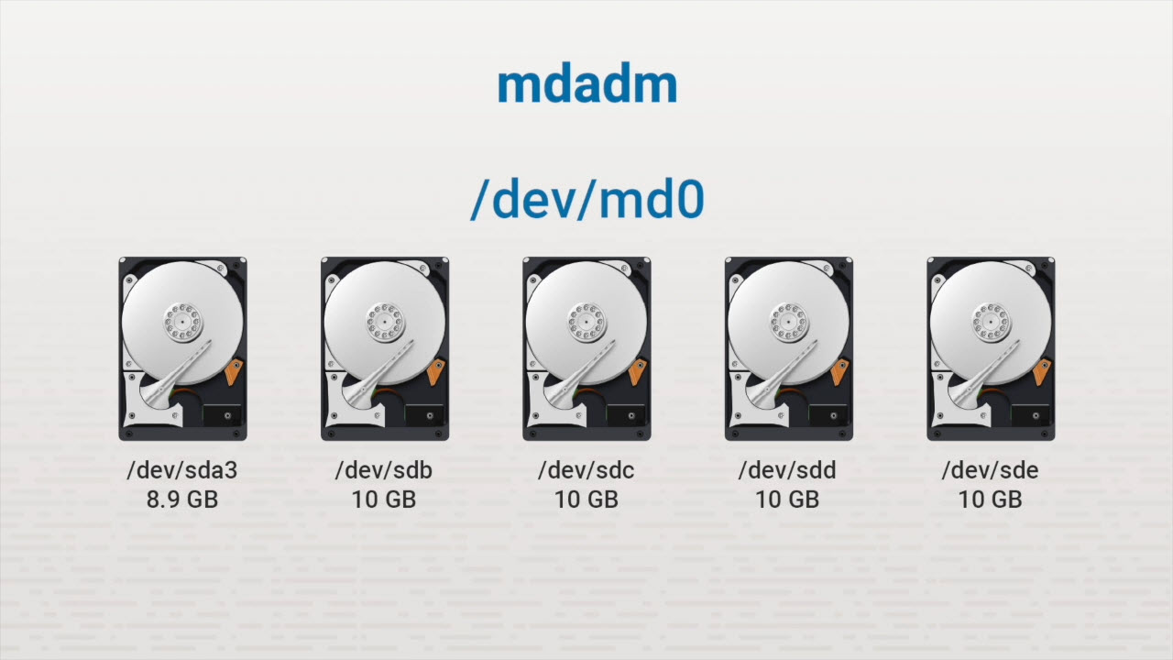
RAID on Linux

Slide 27
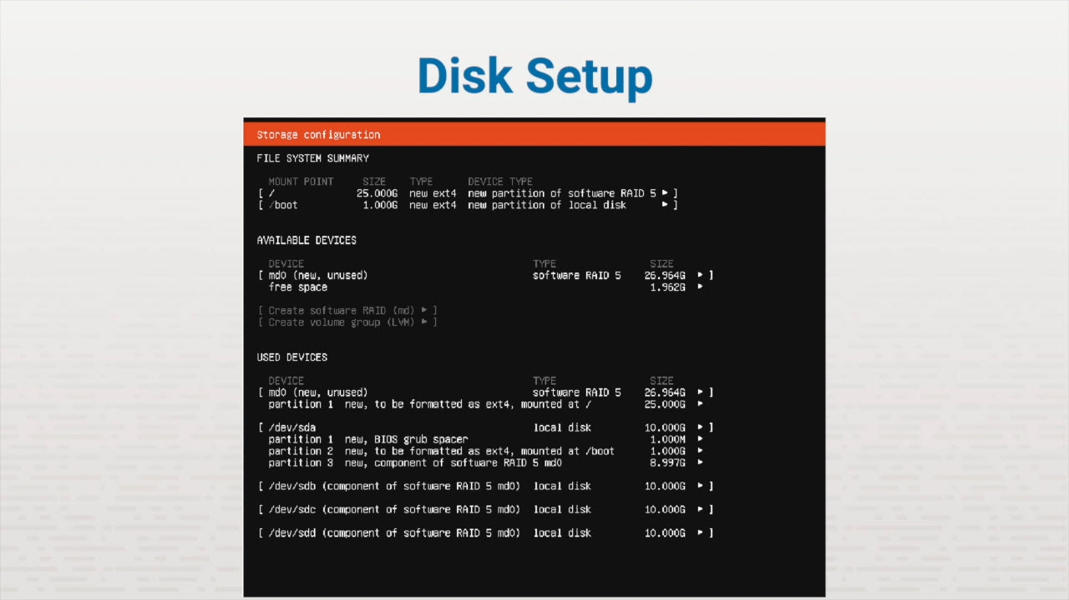
RAID on Linux

Slide 28
RAID Types
RAID 0 - Striping RAID 1 - Mirroring RAID 5 — Striping with parity RAID 10 - Striping w/mirror

Slide 29
MBR Disk Partitions
MBR partitions
The fdisk utility
The partprobe command

Slide 30
Key Terms/Definitions
Partition
Primary partition
Extended partition
Logical partition
Device file
A region on a hard disk that can be managed by an operating system.
An MBR partition that contains only one file system.
An optional partition that can contain multiple logical partitions, each with their own file system.
A partition contained in an extended partition.
An interface for a device driver that appears in the Linux file system under the /dev directory.

Slide 31
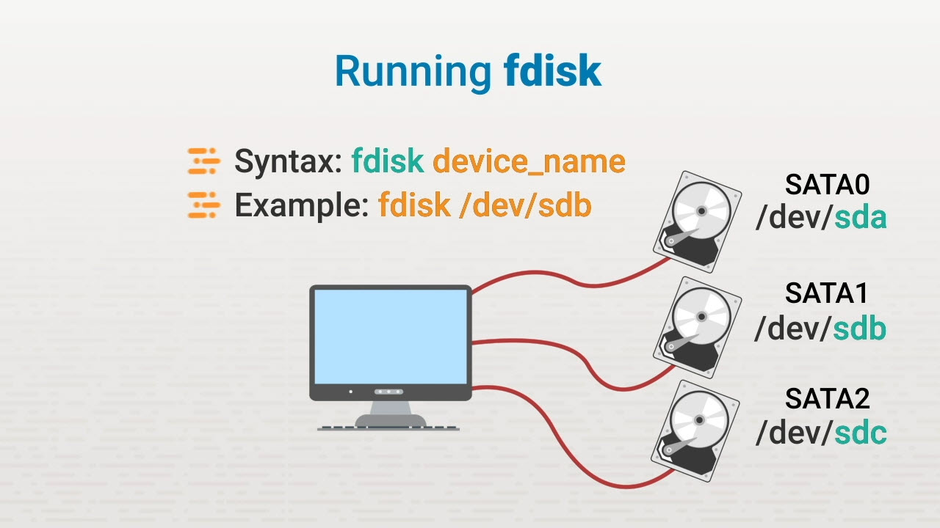
MBR Disk Partitions

Slide 32
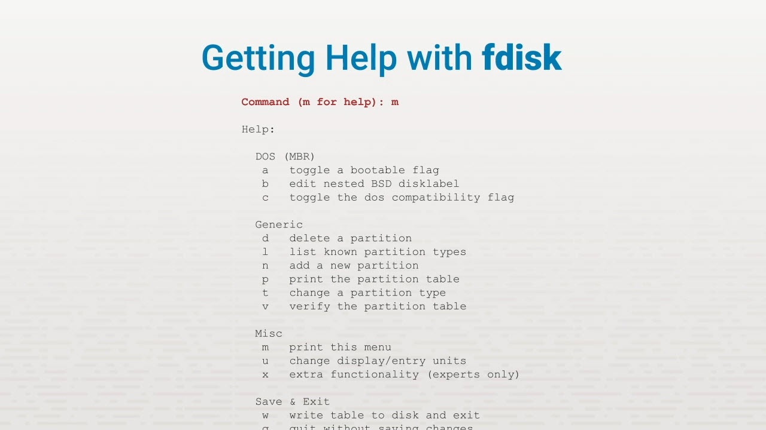
MBR Disk Partitions

Slide 33
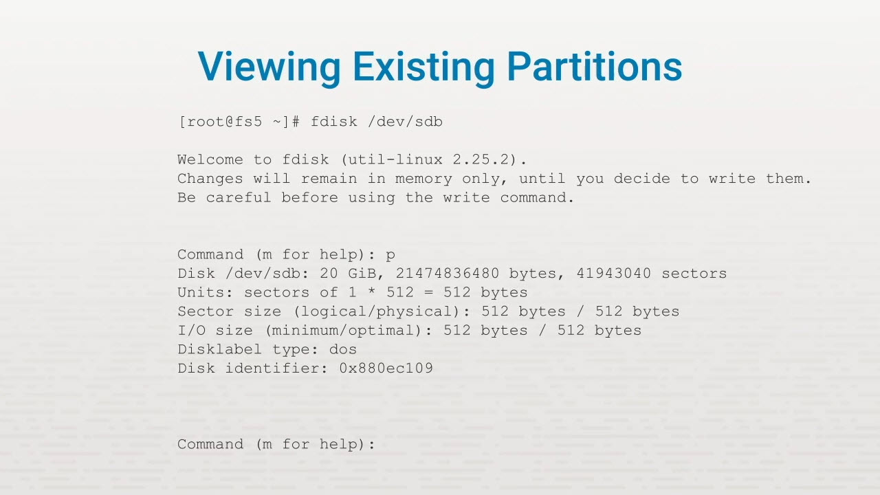
MBR Disk Partitions

Slide 34
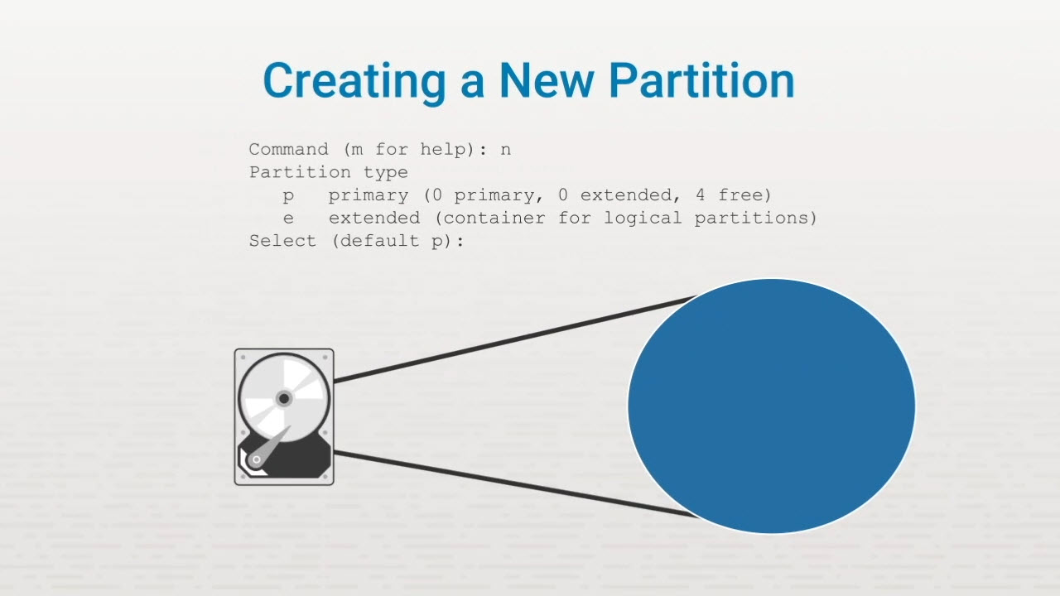
MBR Disk Partitions

Slide 35

MBR Disk Partitions

Slide 36
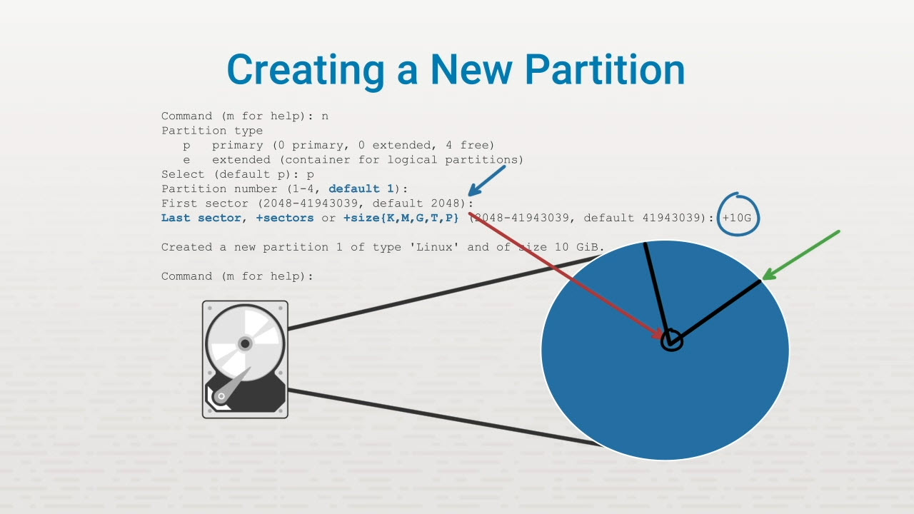
MBR Disk Partitions

Slide 37
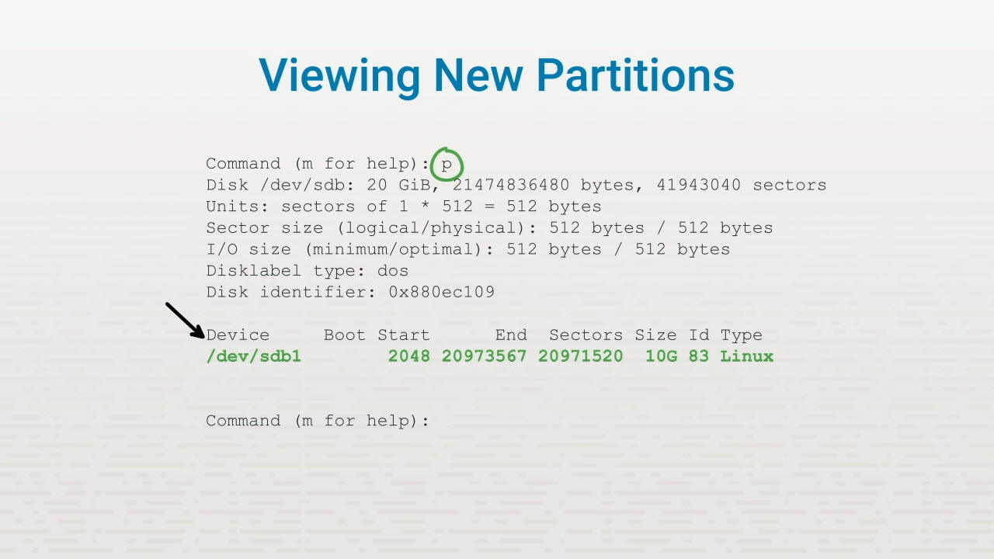
MBR Disk Partitions

Slide 38
Changing Partition Types
Command: t + <ID number of partition type>

Slide 39
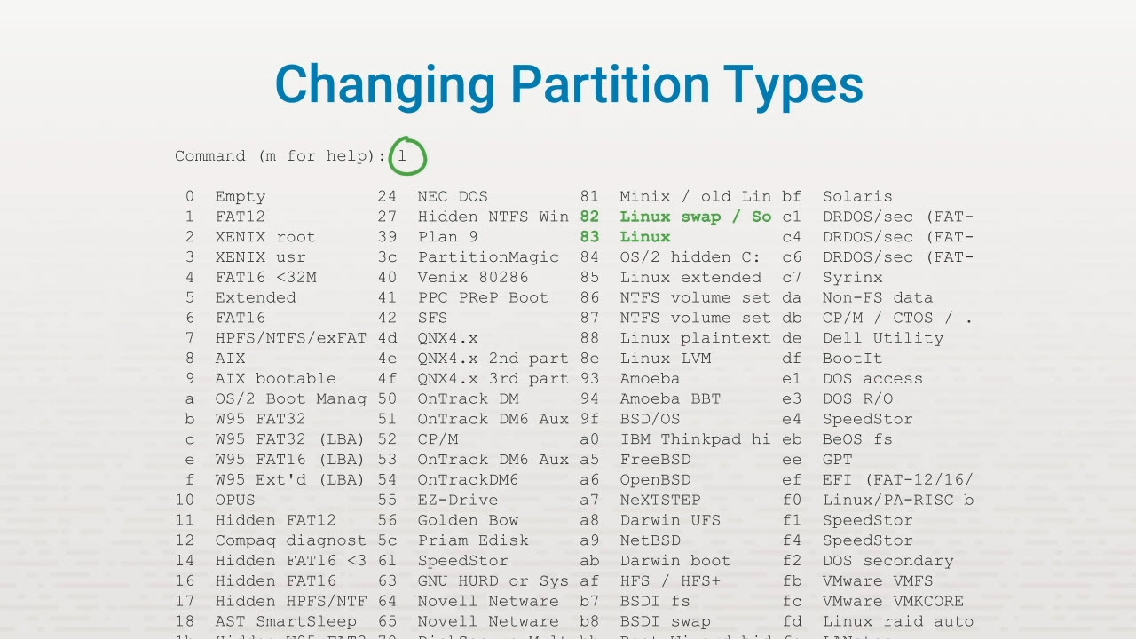
MBR Disk Partitions

Slide 40
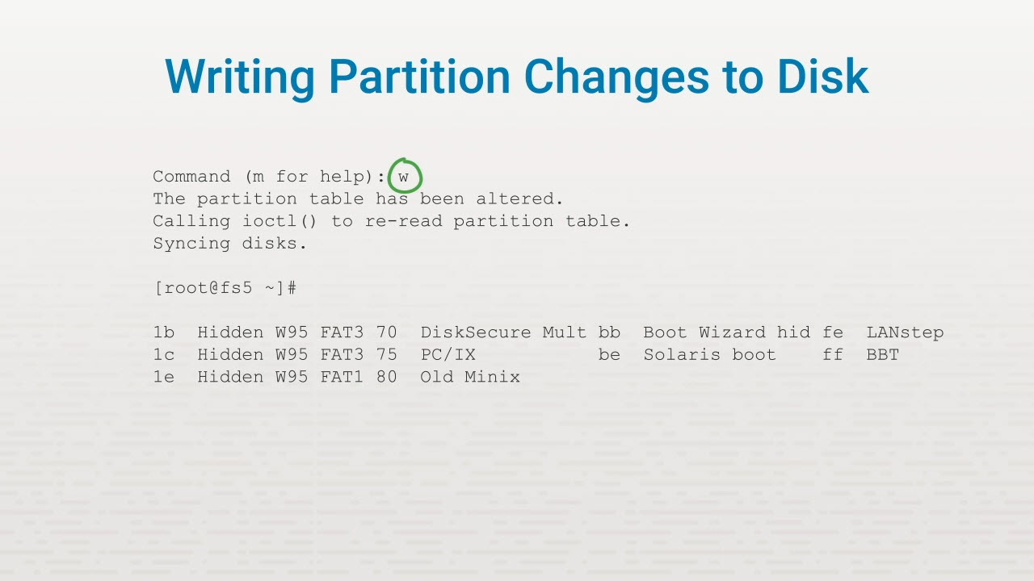
MBR Disk Partitions

Slide 41
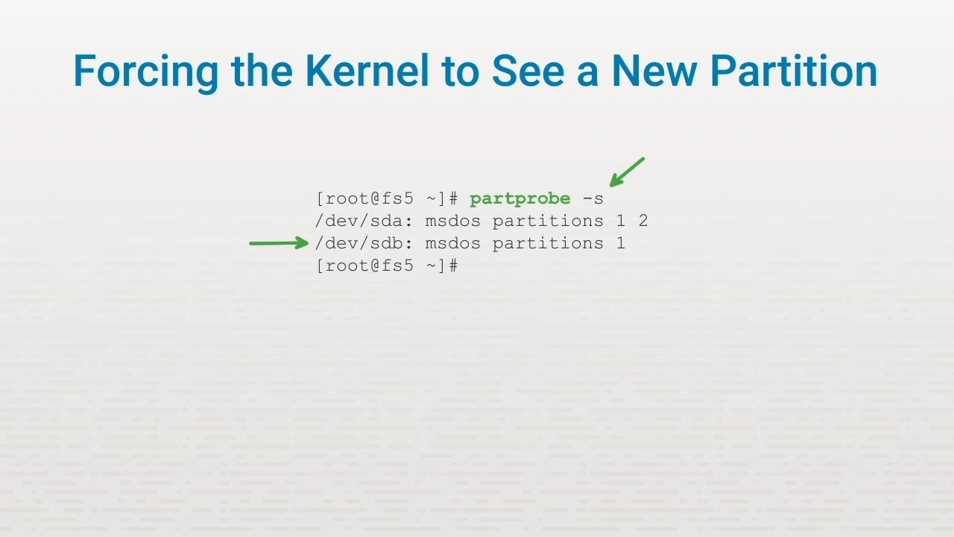
MBR Disk Partitions

Slide 42
GUID Partitions
GUID or GPT partitions
The gdisk utility
The parted utility

Slide 43
Key Terms/Definitions
GUID
GPT
A globally unique identifier or number that is used to uniquely identify an object.
The GUID Partition Table scheme that replaces the MBR partitioning scheme.

Slide 44
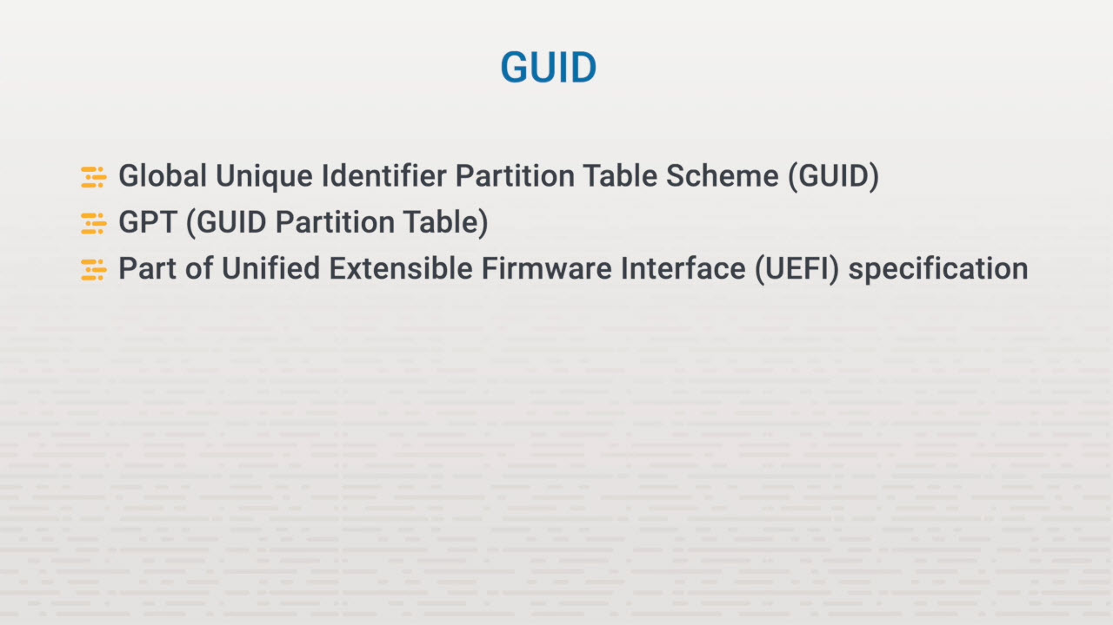
GUID Partitions

Slide 45
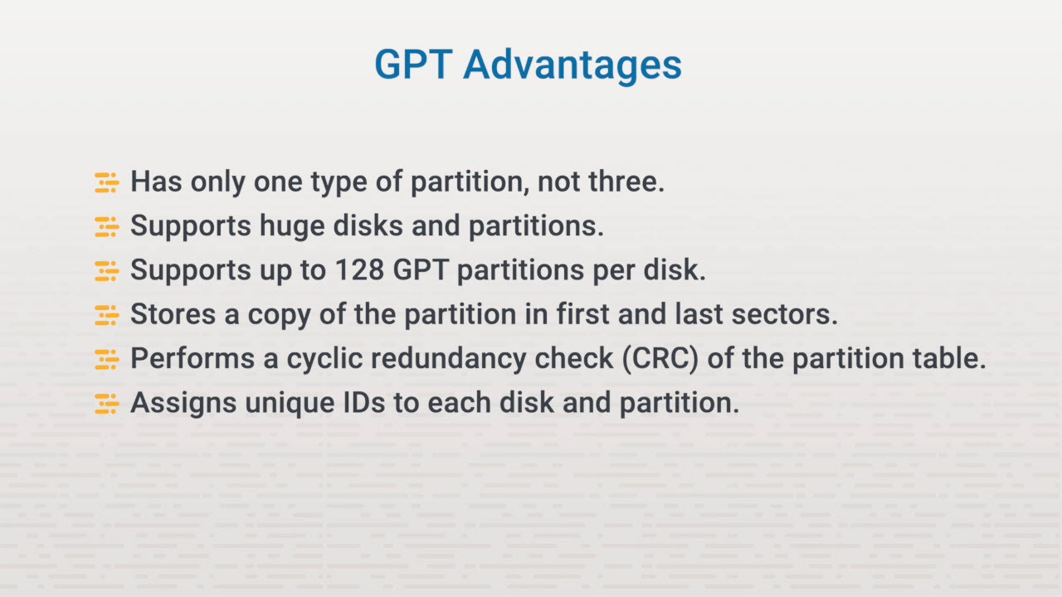
GUID Partitions

Slide 46
gdisk Utility
Convert MBR table to GPT Verify a hard drive Create or delete GPT partitions Display info about partitions Change the name of partition type Back up and restore a partition table

Slide 47
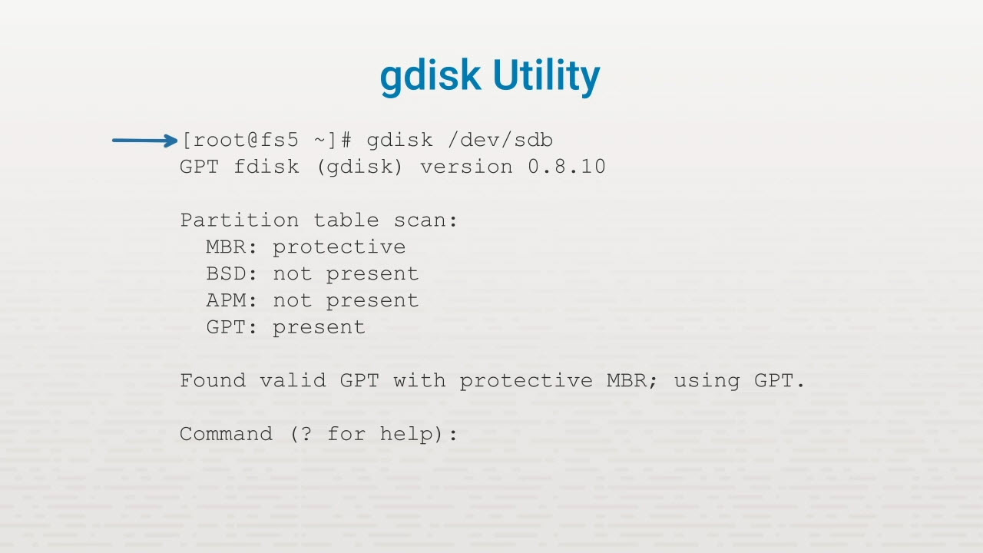
GUID Partitions

Slide 48
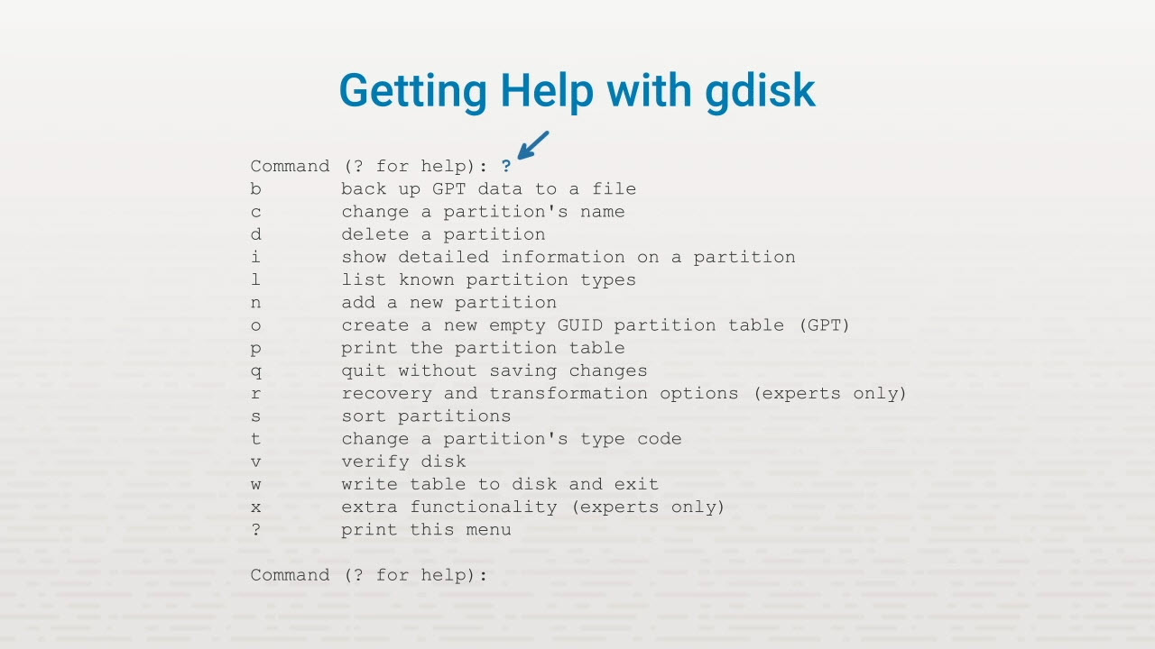
GUID Partitions

Slide 49
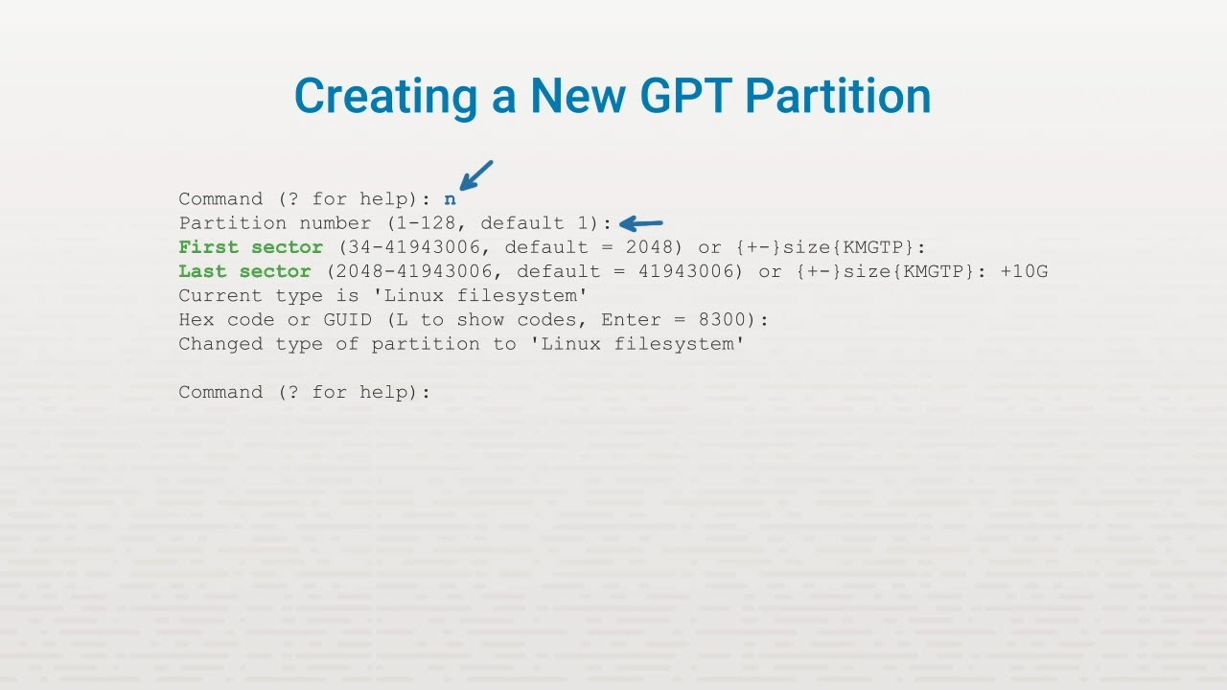
GUID Partitions

Slide 50
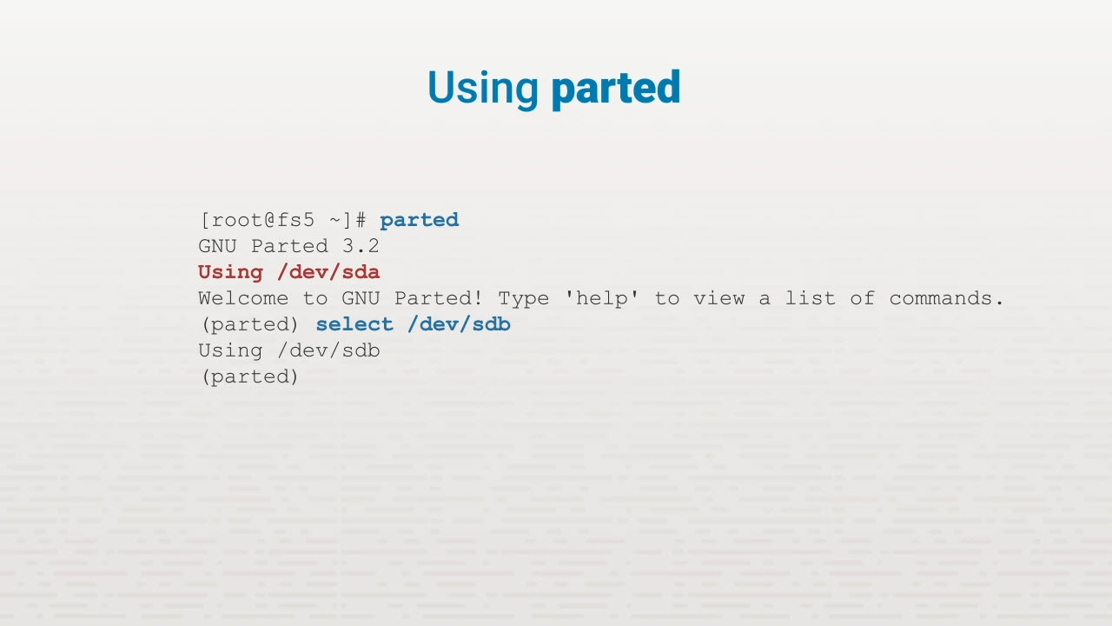
GUID Partitions

Slide 51
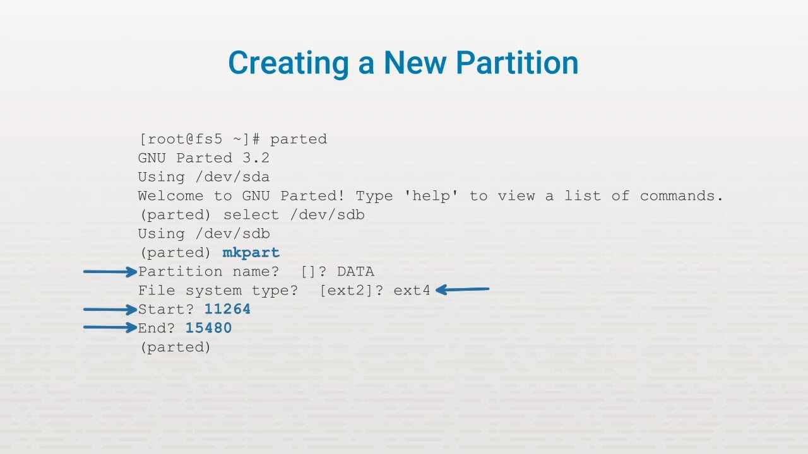
GUID Partitions

Slide 52
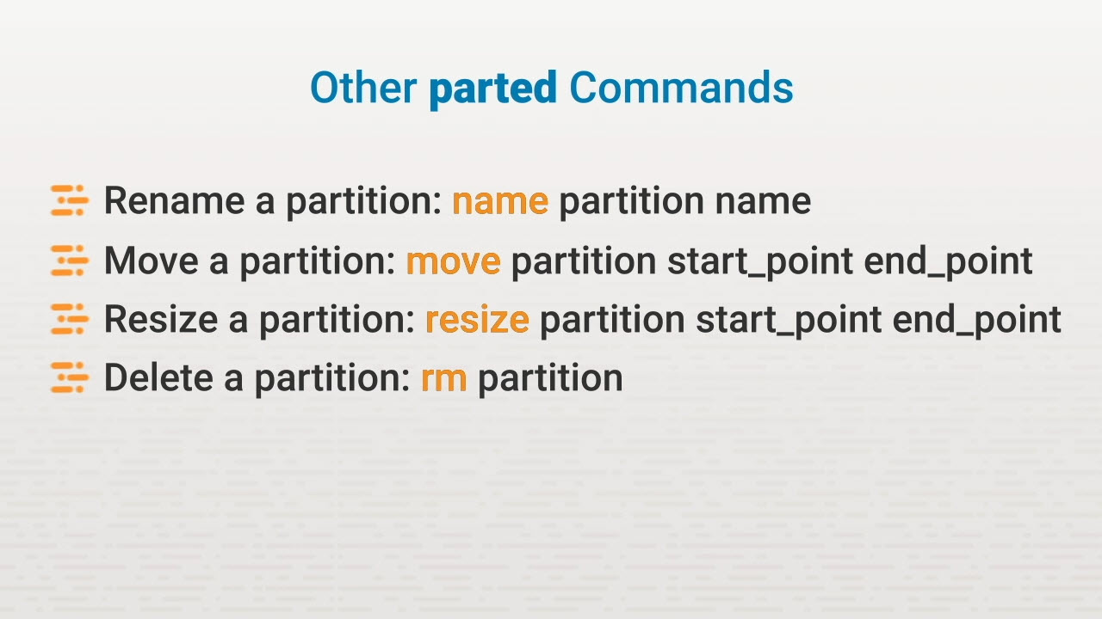
GUID Partitions

Slide 53
Logical Volume Manager
How LVM works
LVM components
Create LVM volumes

Slide 54
Key Terms/Definitions
Logical Volume Manager (LVM)
Physical volume
Volume group
Logical volume
A system of managing logical volumes or file systems made up of physical volumes mapped through a volume group.
Physical block devices or other disk-like devices that LVM uses as the building blocks for volume groups.
An abstract container that combines physical volumes into the storage pools from which logical volumes are created.
A portion of the volume group that can be formatted to accommodate a file system.

Slide 55
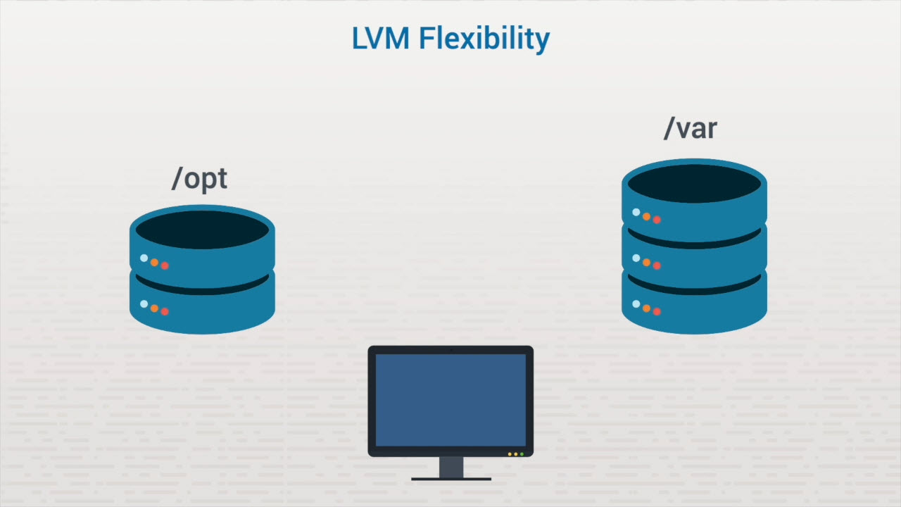
Logical Volume Manager (LVM)

Slide 56
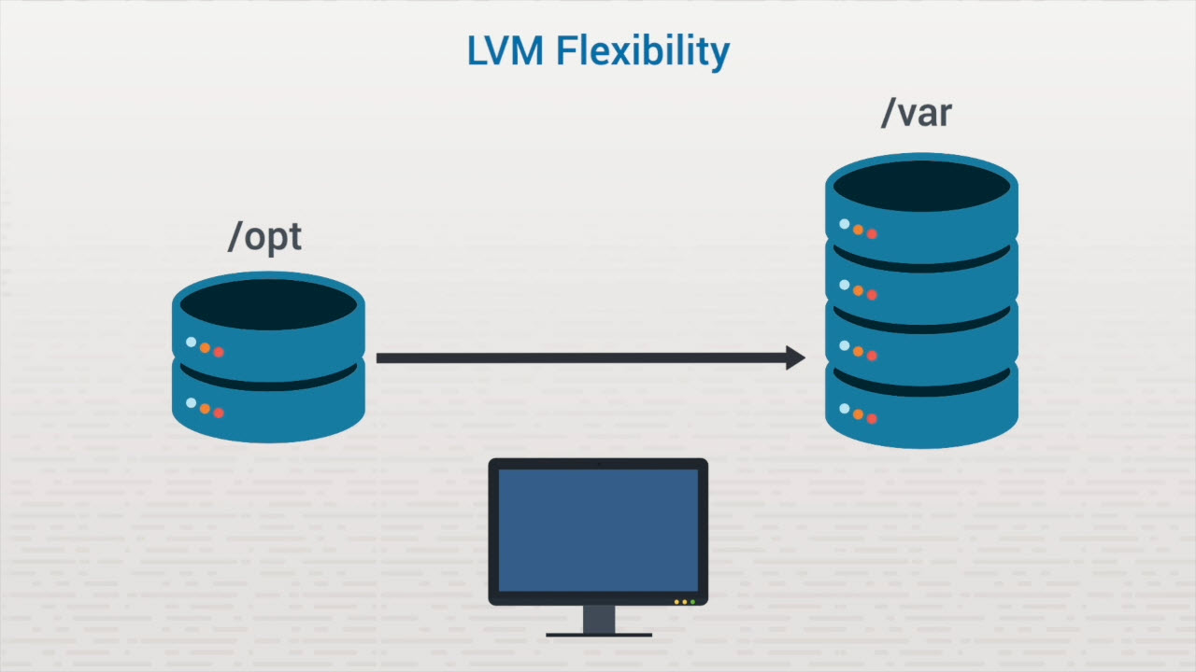
Logical Volume Manager (LVM)

Slide 57
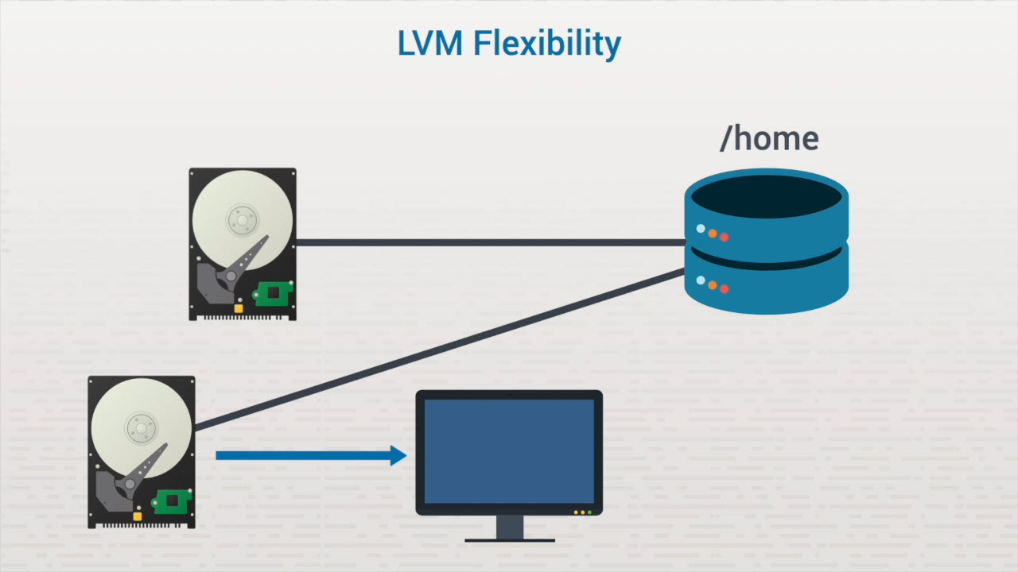
Logical Volume Manager (LVM)

Slide 58
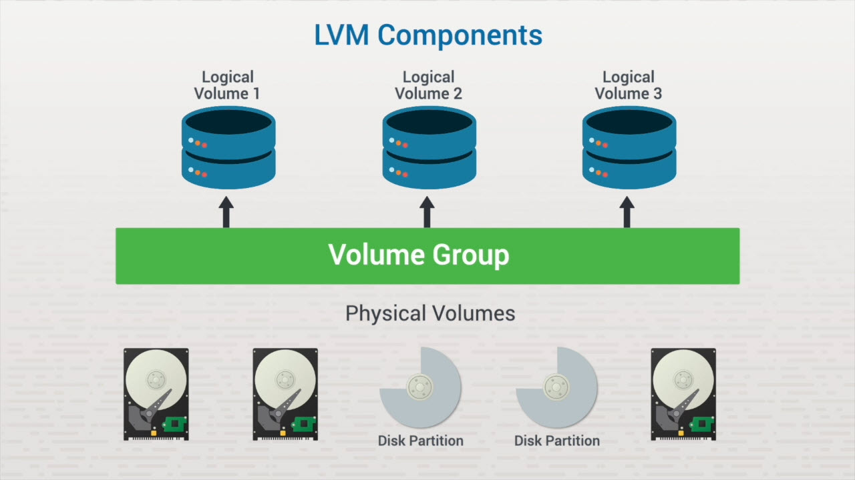
Logical Volume Manager (LVM)

Slide 59
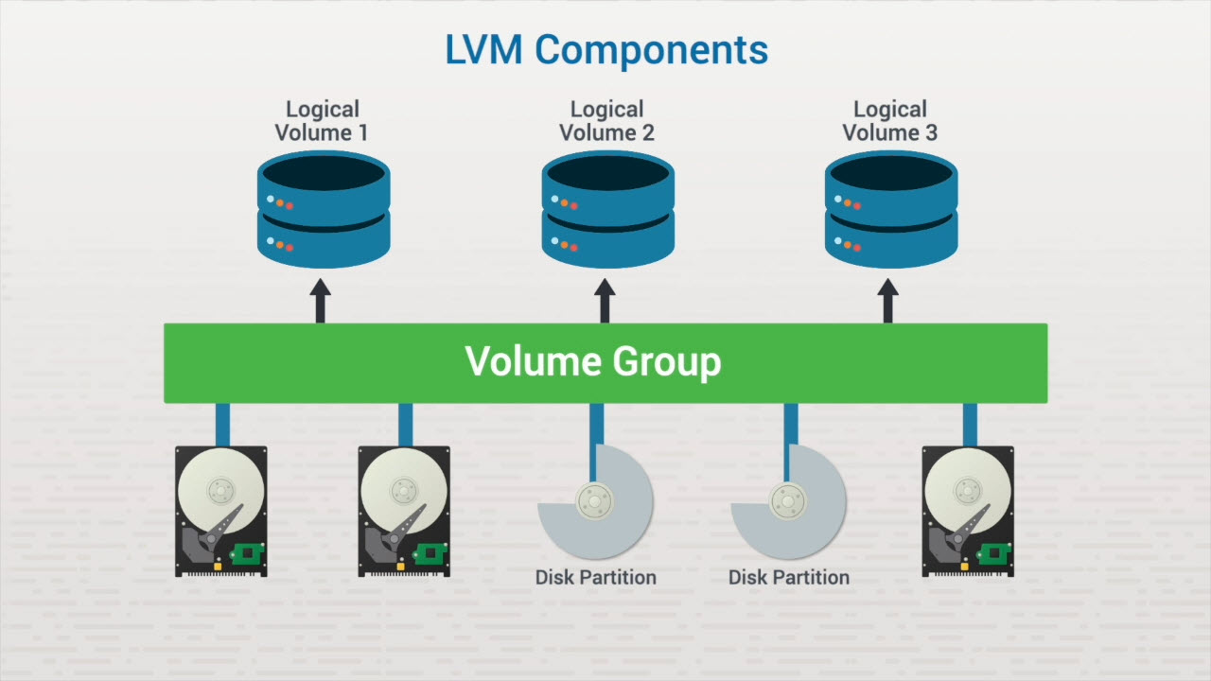
Logical Volume Manager (LVM)

Slide 60
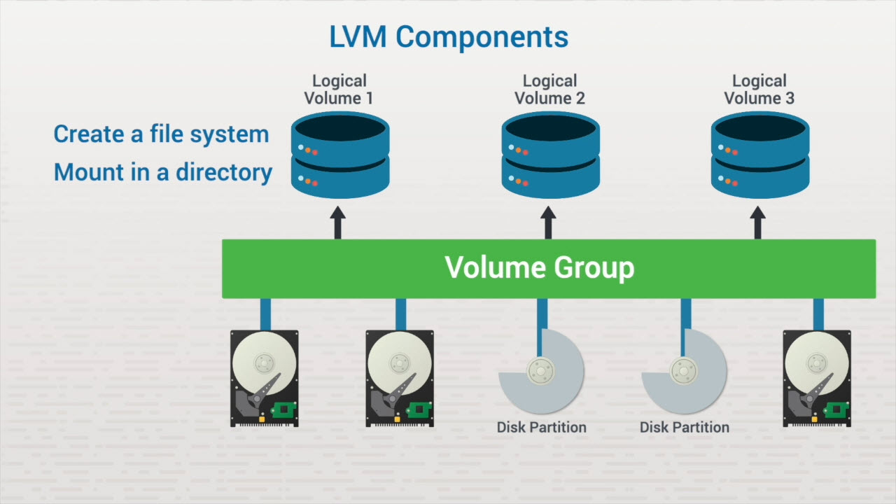
Logical Volume Manager (LVM)

Slide 61
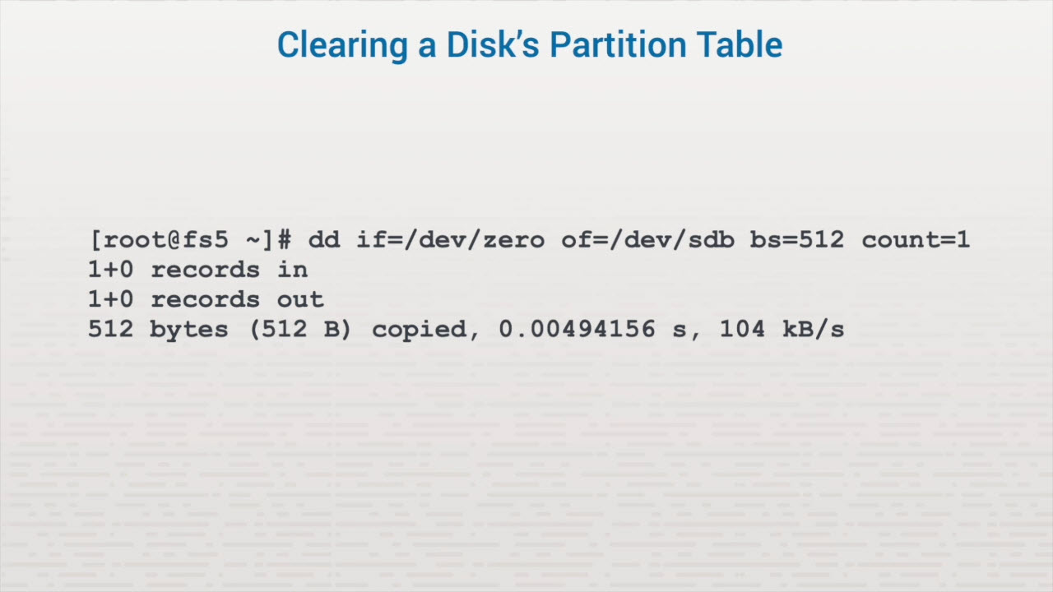
Logical Volume Manager (LVM)

Slide 62
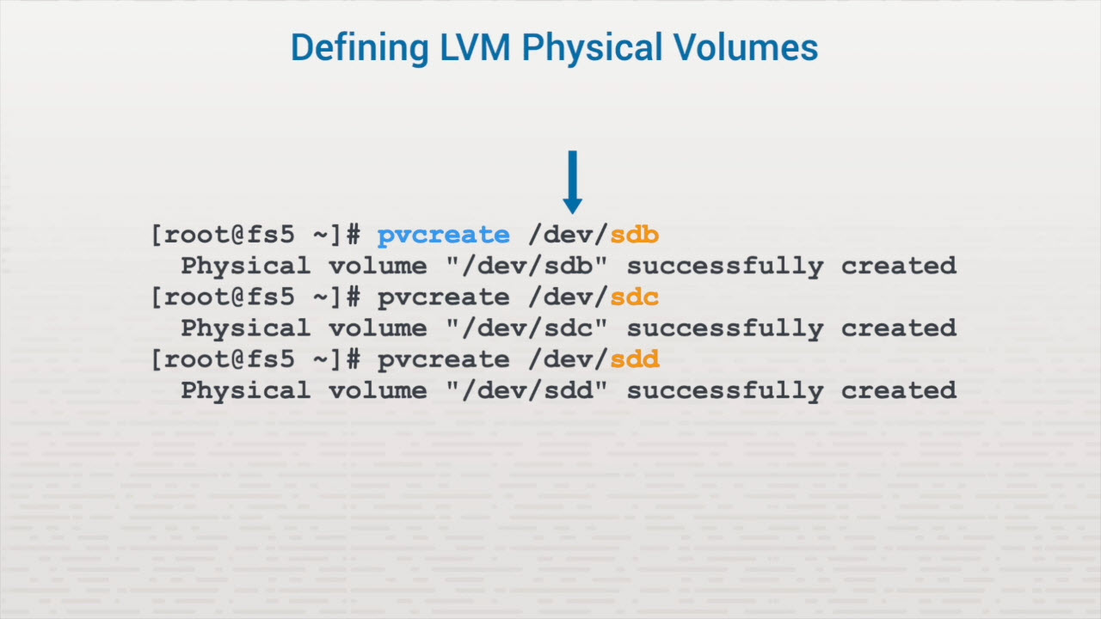
Logical Volume Manager (LVM)

Slide 63
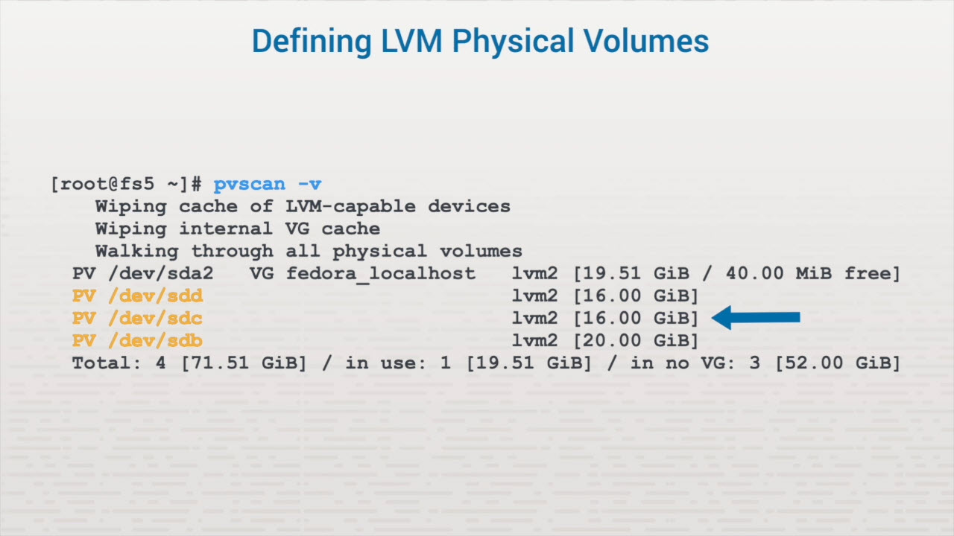
Logical Volume Manager (LVM)

Slide 64
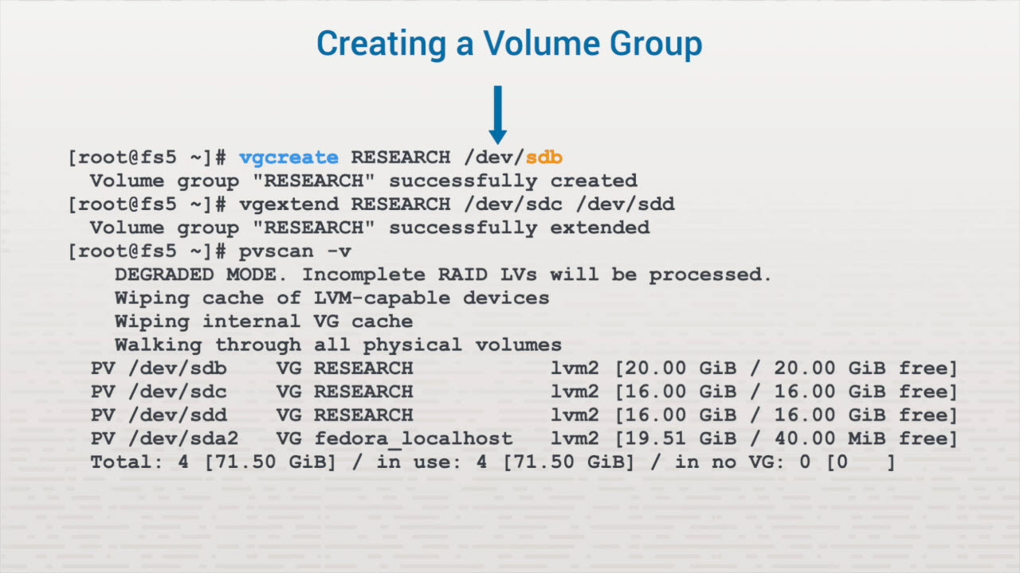
Logical Volume Manager (LVM)

Slide 65
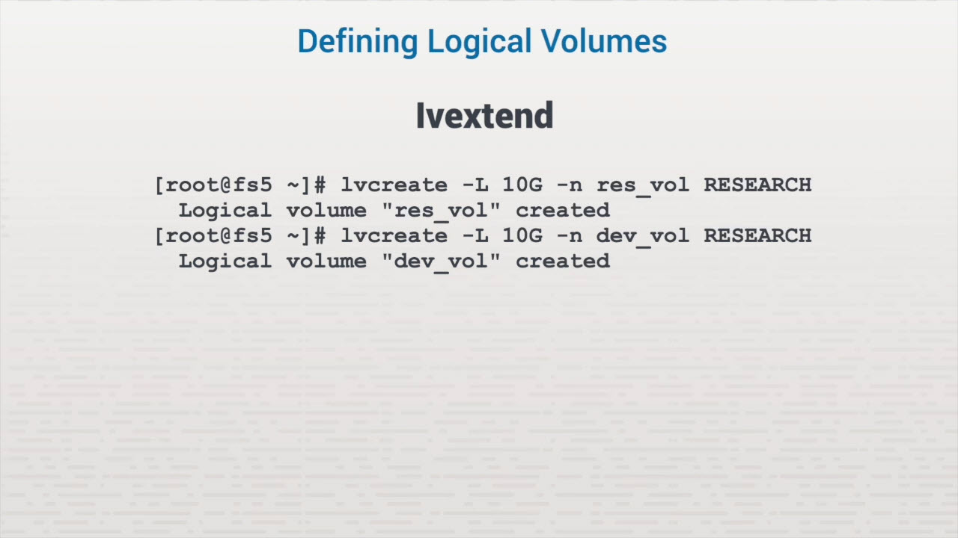
Logical Volume Manager (LVM)

Slide 66
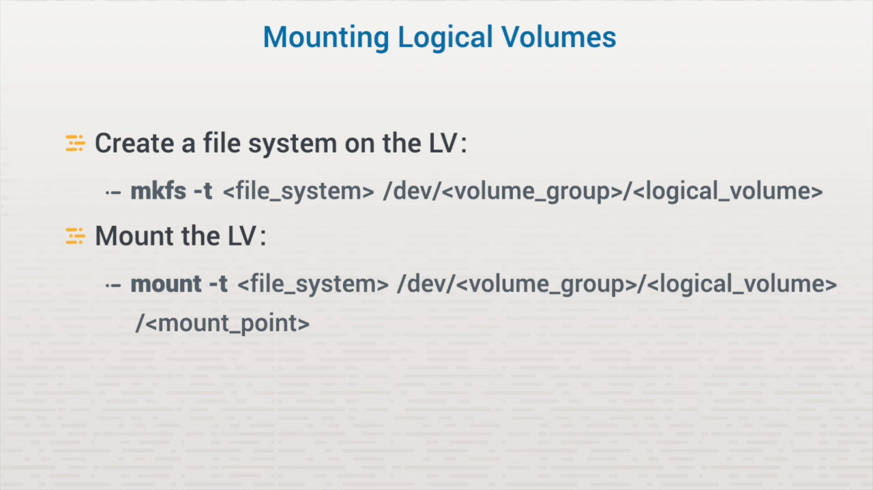
Logical Volume Manager (LVM)

Slide 67
File Systems
File Types (ext2, ext3, ext4, and btrfs)
File System Creation (role/function and mkfs (extx) & mkfs (FAT, NTFS) commands)
Swap Area Management (manage swap areas and mkswap, swapon, and swapoff commands)

Slide 68
Key Terms/Definitions
File system
Swap file
New Technology File System (NTFS)
A system that specifies how data is organized and stored on storage media.
A partition that the operating system uses as virtual memory.
The file system used by Microsoft operating systems.

Slide 69
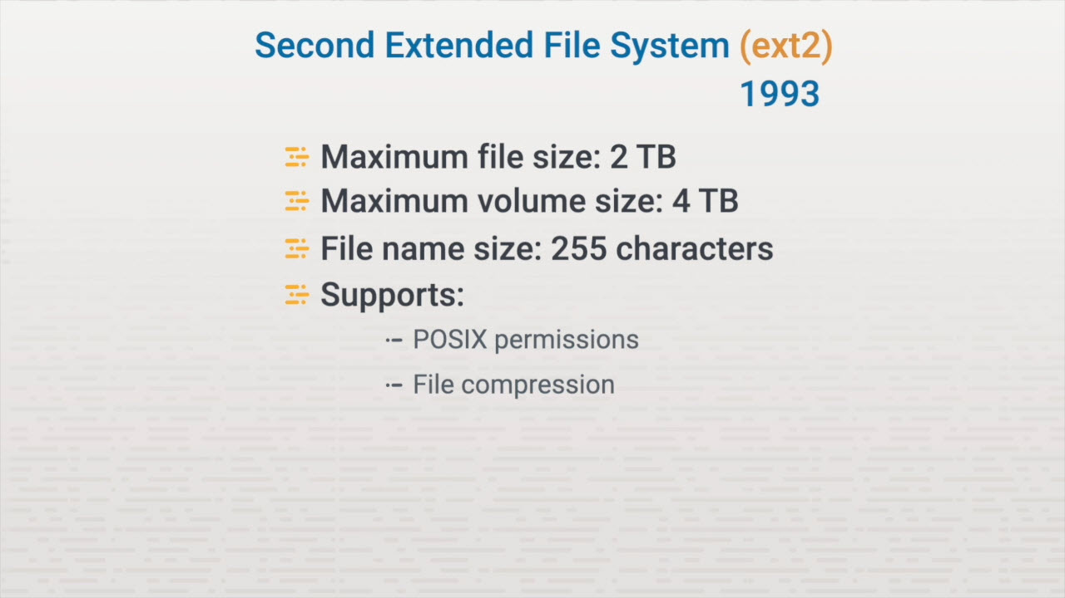
Linux File System Types

Slide 70
Ext2 File System Check (e2fsck)
Fixes shutdown problems Finds unallocated files and uclaimed data
Writes data to lost+found Is time-consuming Analyzes entire system

Slide 71
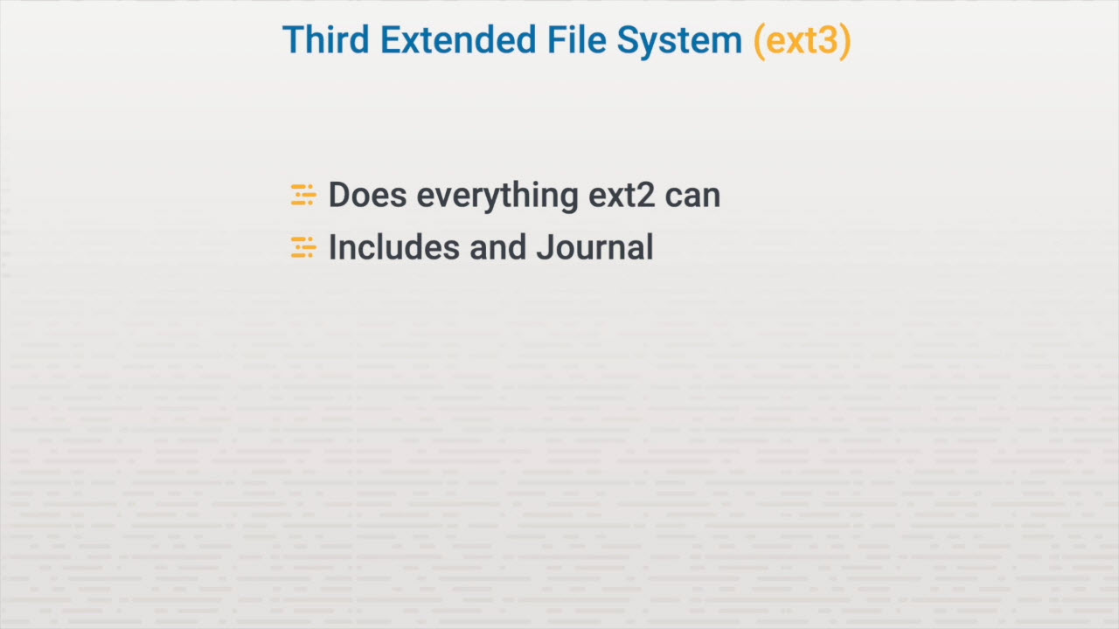
Linux File System Types

Slide 72
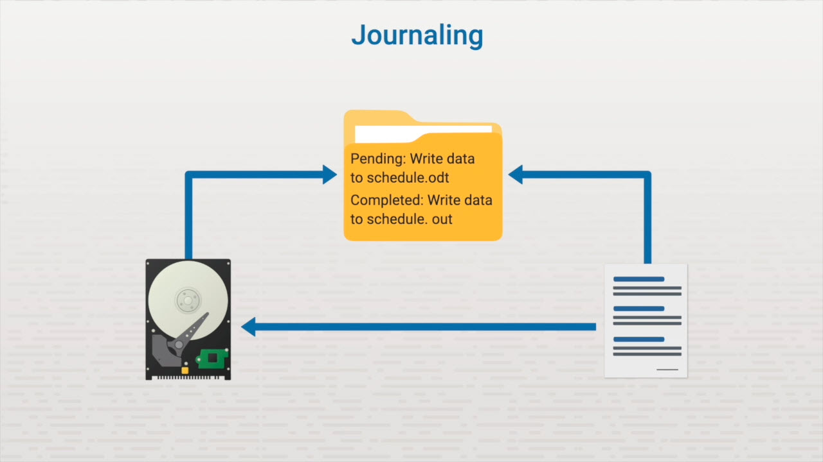
Linux File System Types

Slide 73
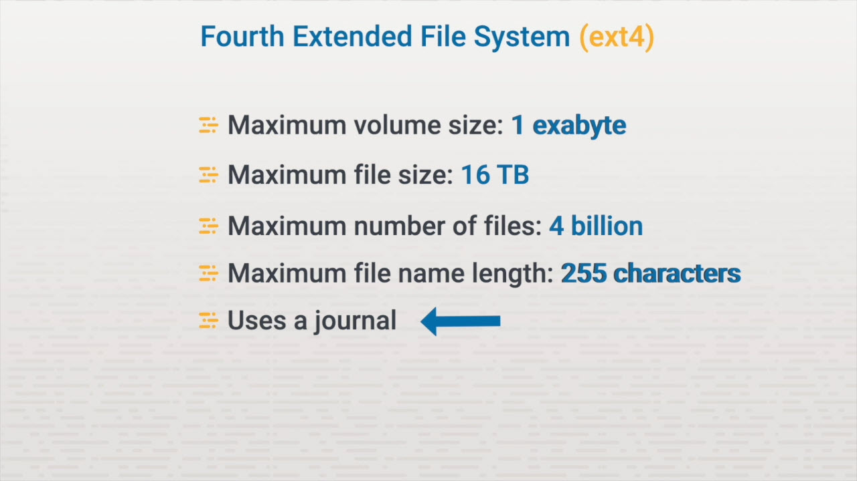
Linux File System Types

Slide 74

Linux File System Types

Slide 75

Linux File System Types

Slide 76

Linux File System Types

Slide 77

Linux File System Types

Slide 78

File System Creation

Slide 79

File System Creation

Slide 80

File System Creation

Slide 81

File System Creation

Slide 82

File System Creation

Slide 83

File System Creation

Slide 84

File System Creation

Slide 85

File System Creation

Slide 86

File System Creation

Slide 87

Swap Area Management

Slide 88

Swap Area Management

Slide 89

Swap Area Management

Slide 90

Swap Area Management

Slide 91

Swap Area Management

Slide 92

Swap Area Management

Slide 93
Mounting File Systems
mount
df

Slide 94
Key Terms/Definitions
mount
df
View the currently mounted volumes on the system.
View which file systems are mounted to specific mount points.

